Slide 1
Team 7: Mohamed Eraky, Mahmoud Nassar, Anish Khilani
Linear Machine Learning model to predict Concrete Strength

Slide 2
Contents
Problem Description & Data analysis.
Handling outliers.
Machine learning model.
PCA analysis.

Slide 3
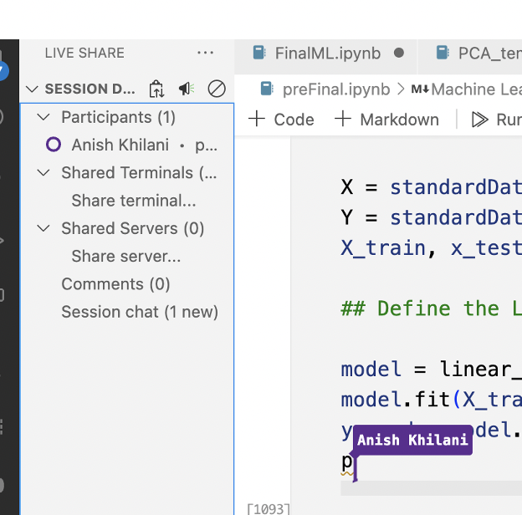
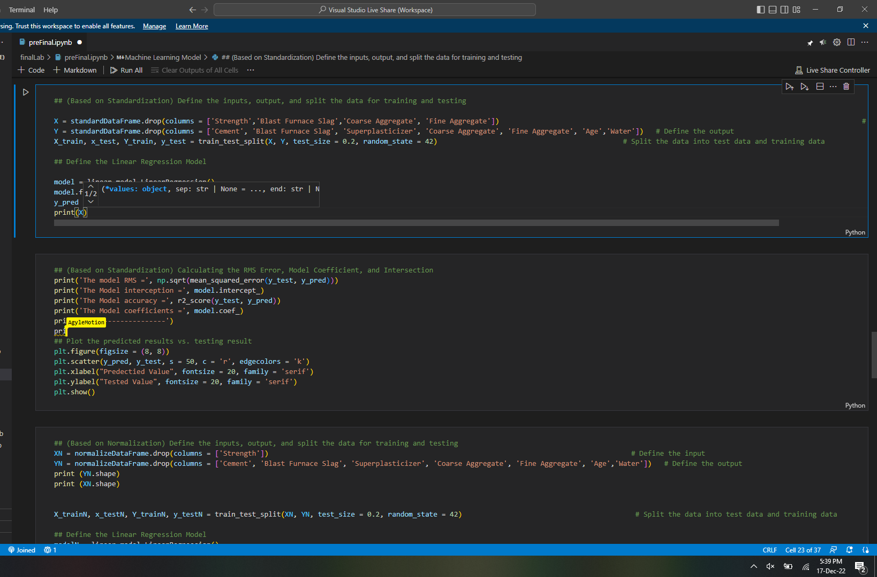
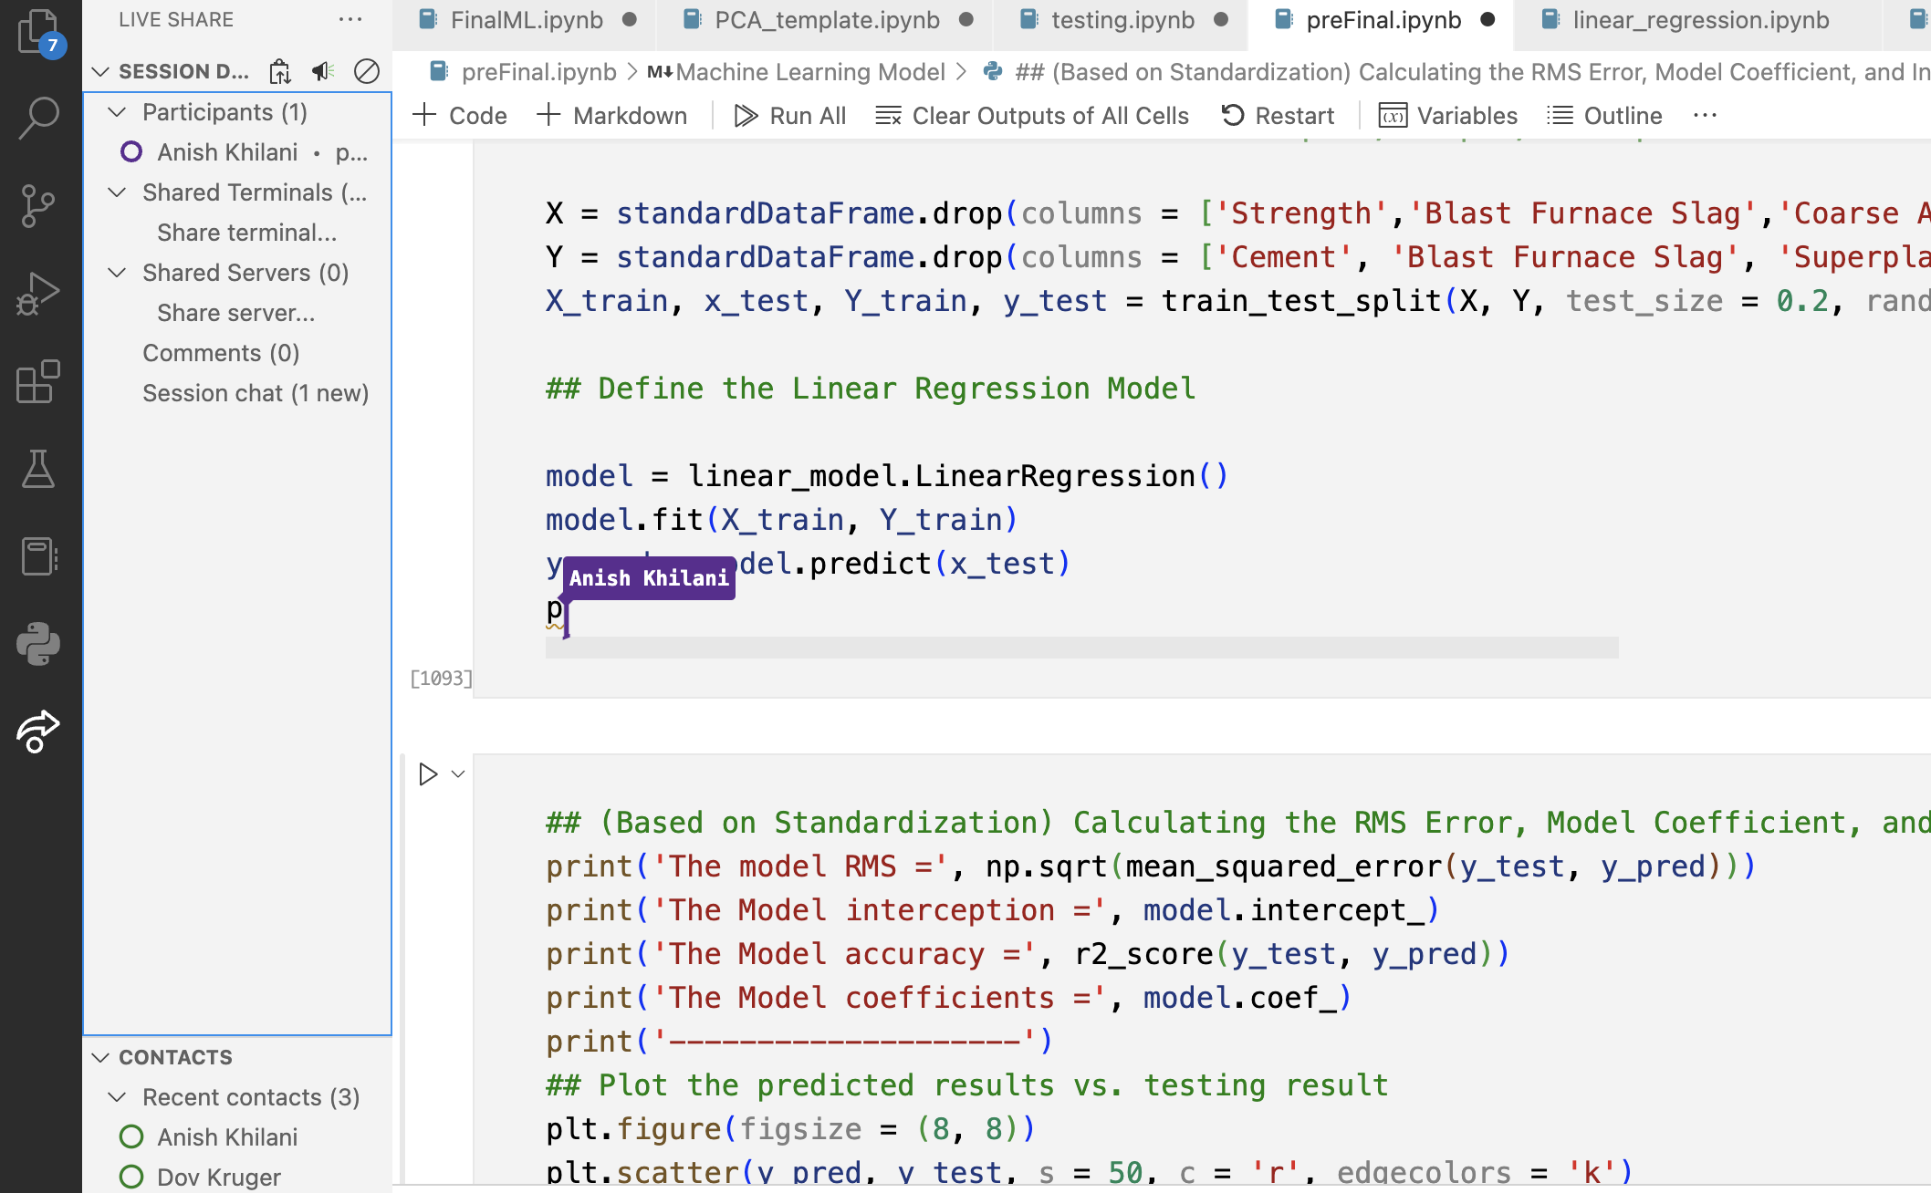
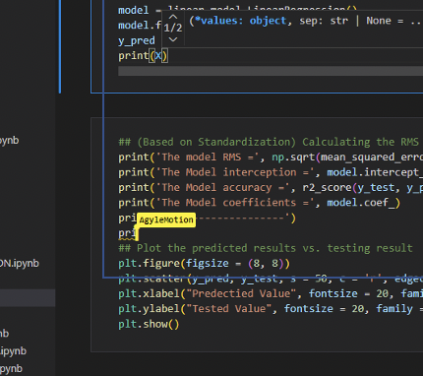
Team collaboration ( Live share on VS code)
Notes:
Mohamed : live share enables collaboration ” editing, in real-time between team members “

Slide 4
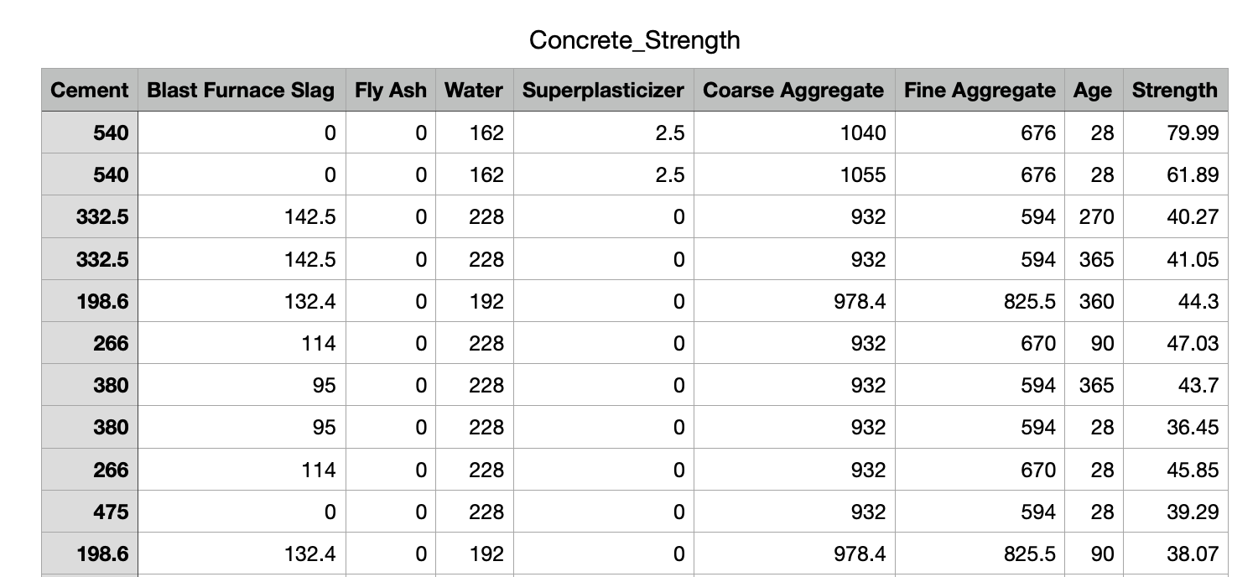
Problem description
Target : Concrete Strength
Number of Features : 8
Least-square –Machine learning model , PCA
Notes:
Machine learning model to optimize the strength/ unit weight of given batch ingredients, produce a certain target strength. Linear regression model with least square. Principal component analysis.

Slide 5
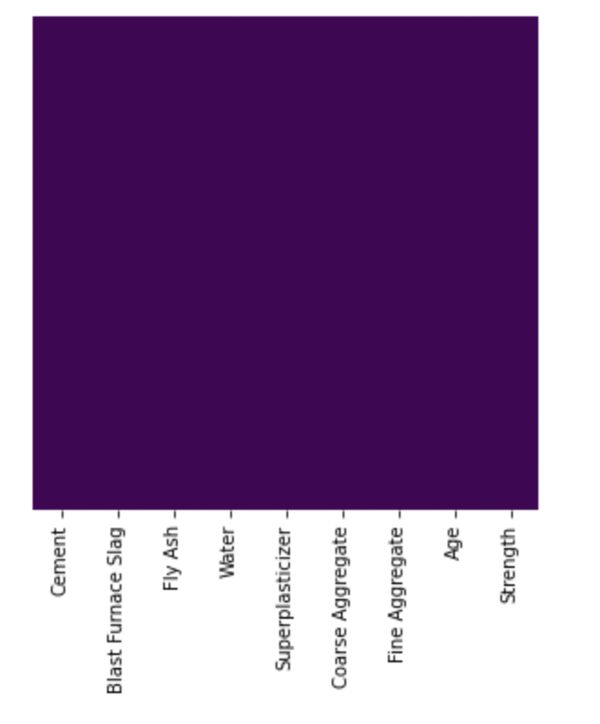
Data Analysis : Checking missing data
Data frame shape (raw): 1030 x 9
Data frame after removing Duplicates :1005 x 9
Find if any missing data using heatmap.
Used library by seaborn, and PyPlot to visualize the heatmap.
Heat Map
Notes:
Mahmoud

Slide 6
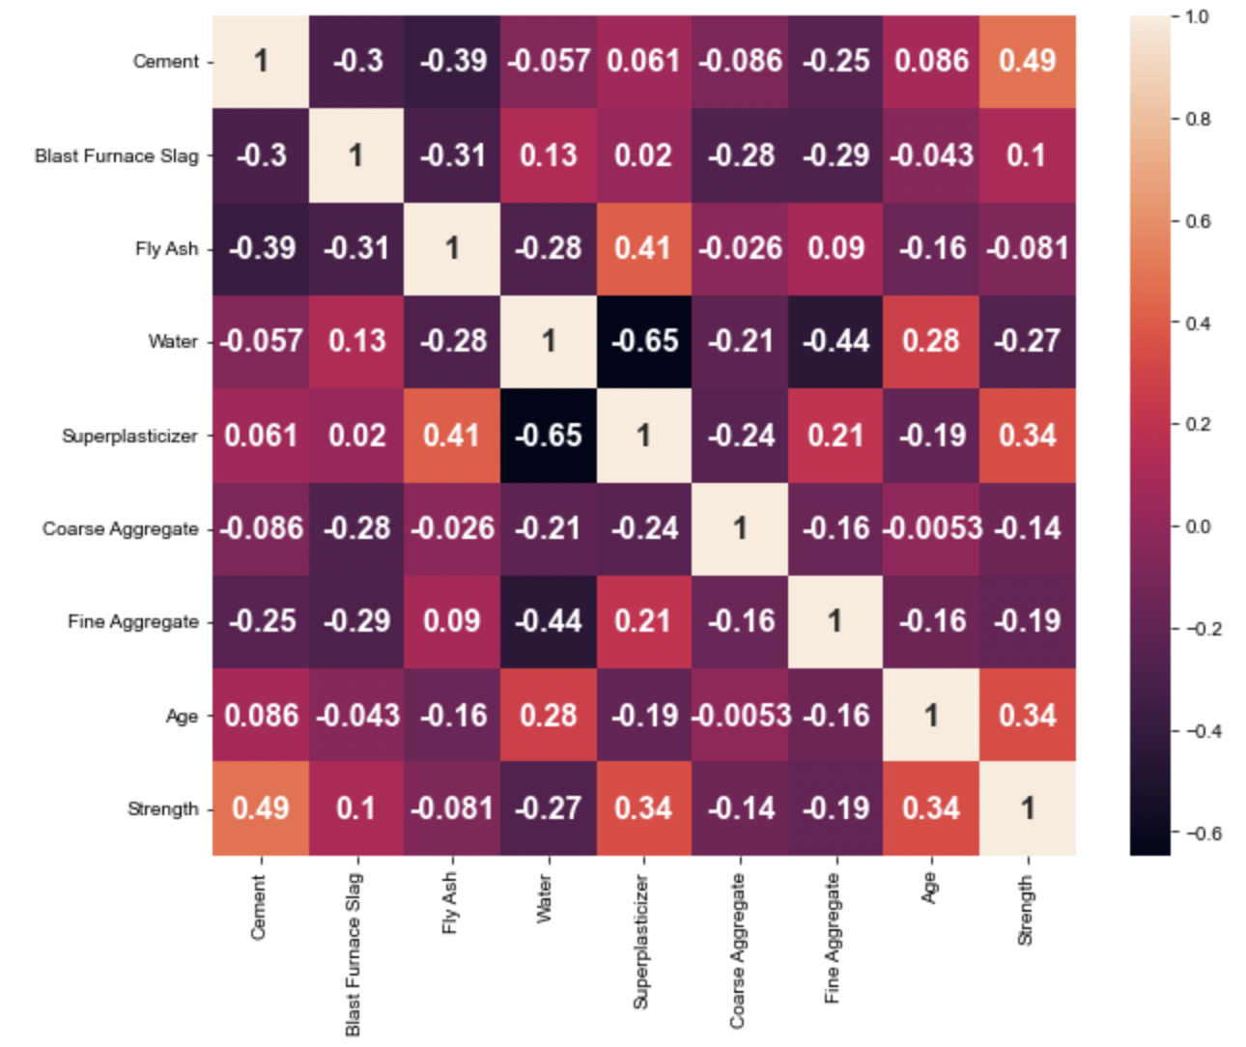
Conclusion: 1) 'Water' is highly negative correlated with 'Superplasticizer'. 4) 'Water' is moderately negative corelated with 'Fine Aggregate'. 2) 'Fly Ash' is moderately negative correlated with Cement'. 3) 'Fly Ash' is moderately correlated with 'Superplasticizer'. Preliminary decision (drop the following feature): 1) Fly Ash
Finding correlation Matrix for Data frame
Features : Cement, Superplasticizer, Age have the highest correlation with strength.
Water has highest –Ve correlation with strength.
Fly Ash has the lowest correlation with Strength.
Notes:
Mahmoud

Slide 7
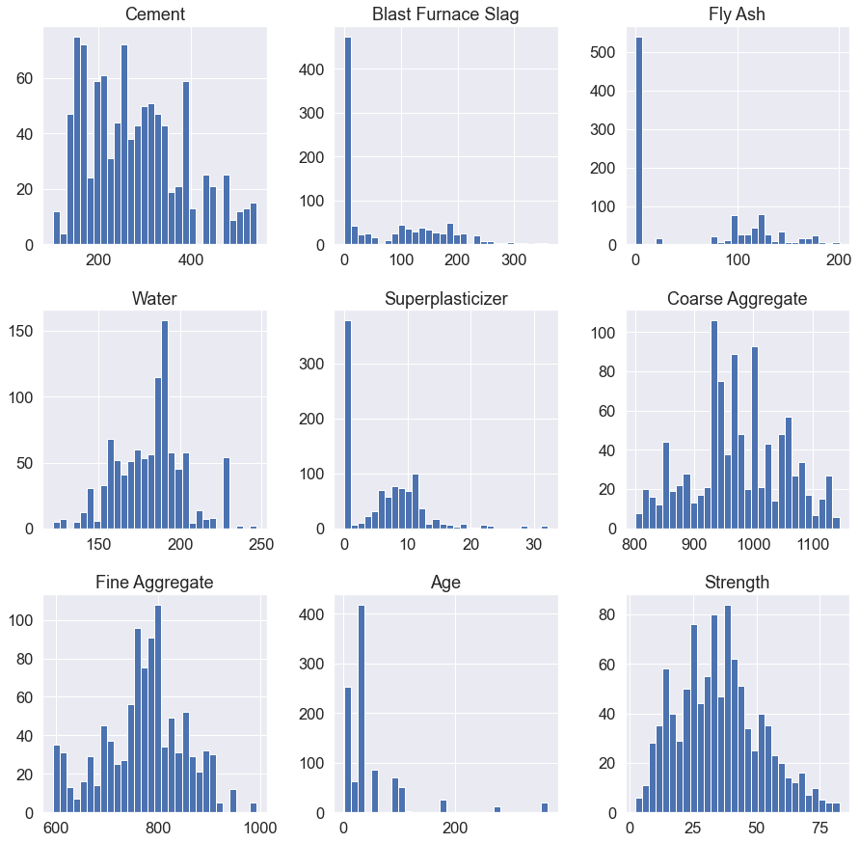
Data Analysis : Data Distribution
Notes:
Mahmoud

Slide 8
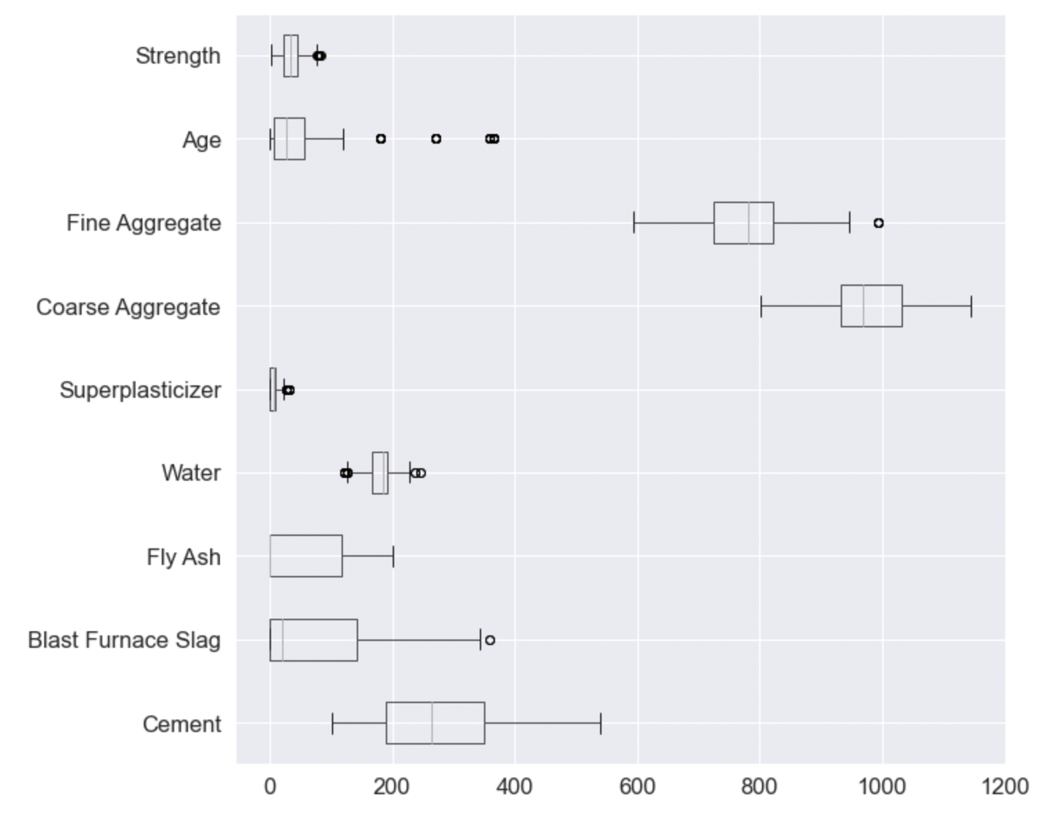
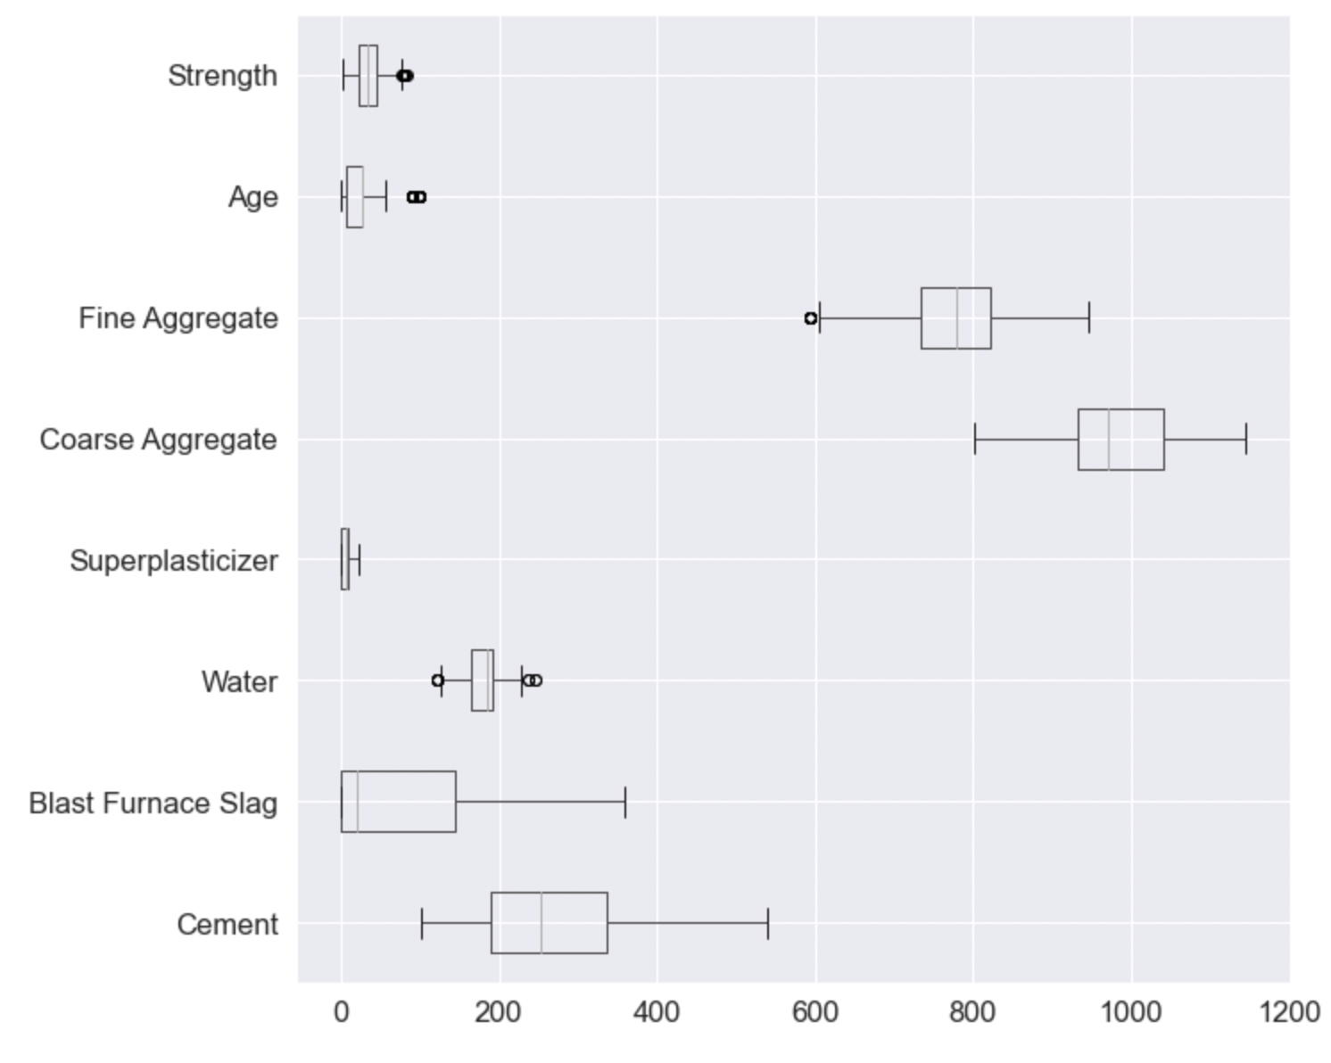
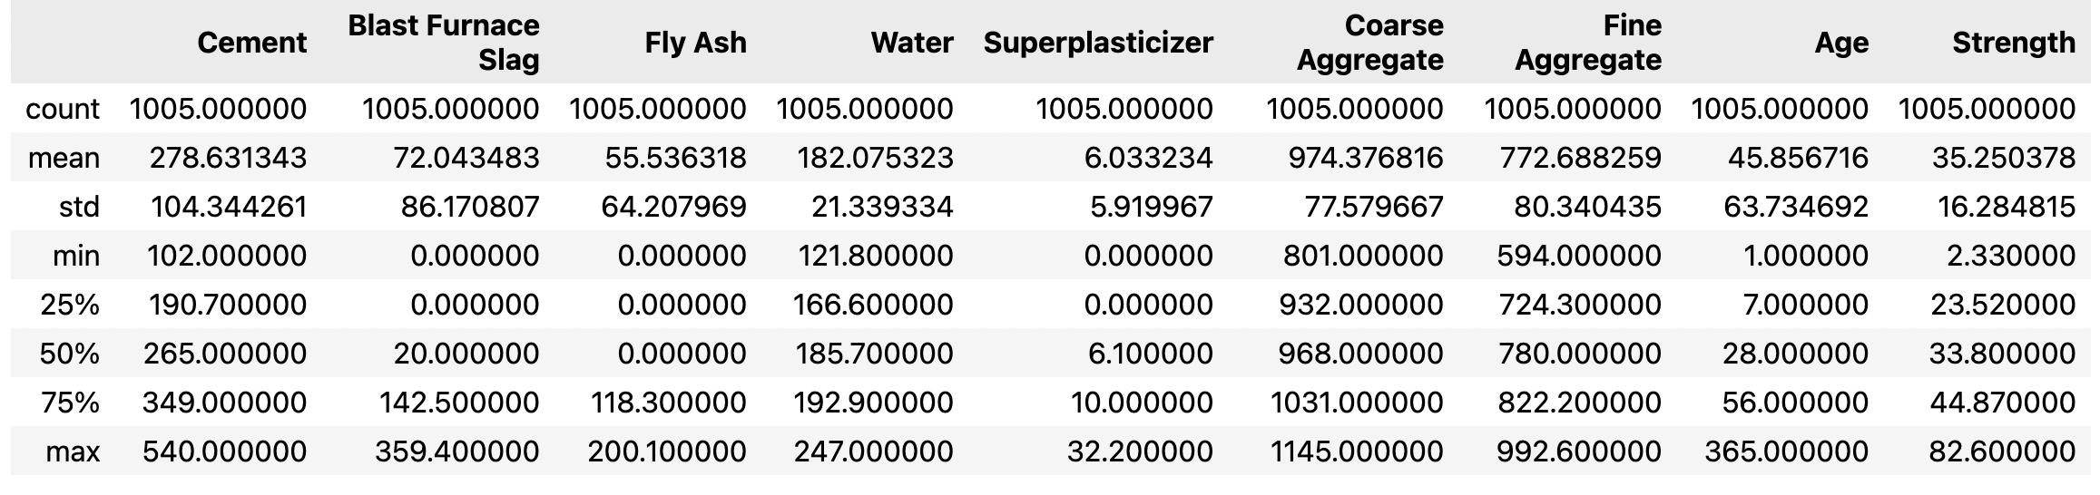
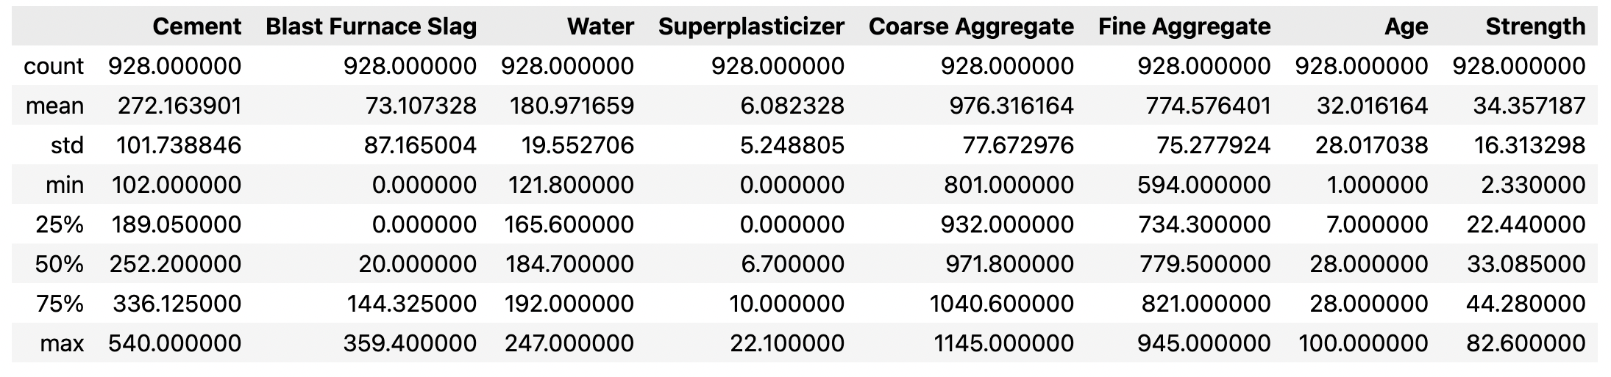
Data Analysis : Plotting data distribution and box plot
IQR, 62 outliers
IQR, 5 outliers
IQR, 10 outliers
Notes:
Mohamed: box plot to identify the outliers graphically.

Slide 9
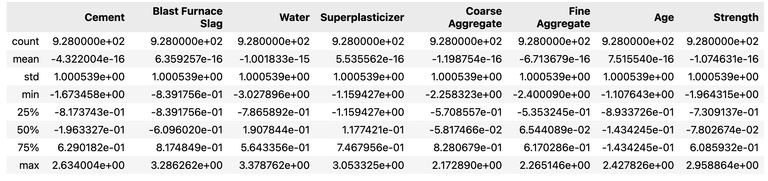
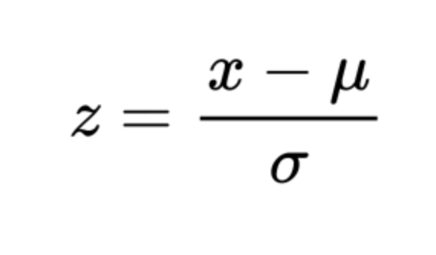
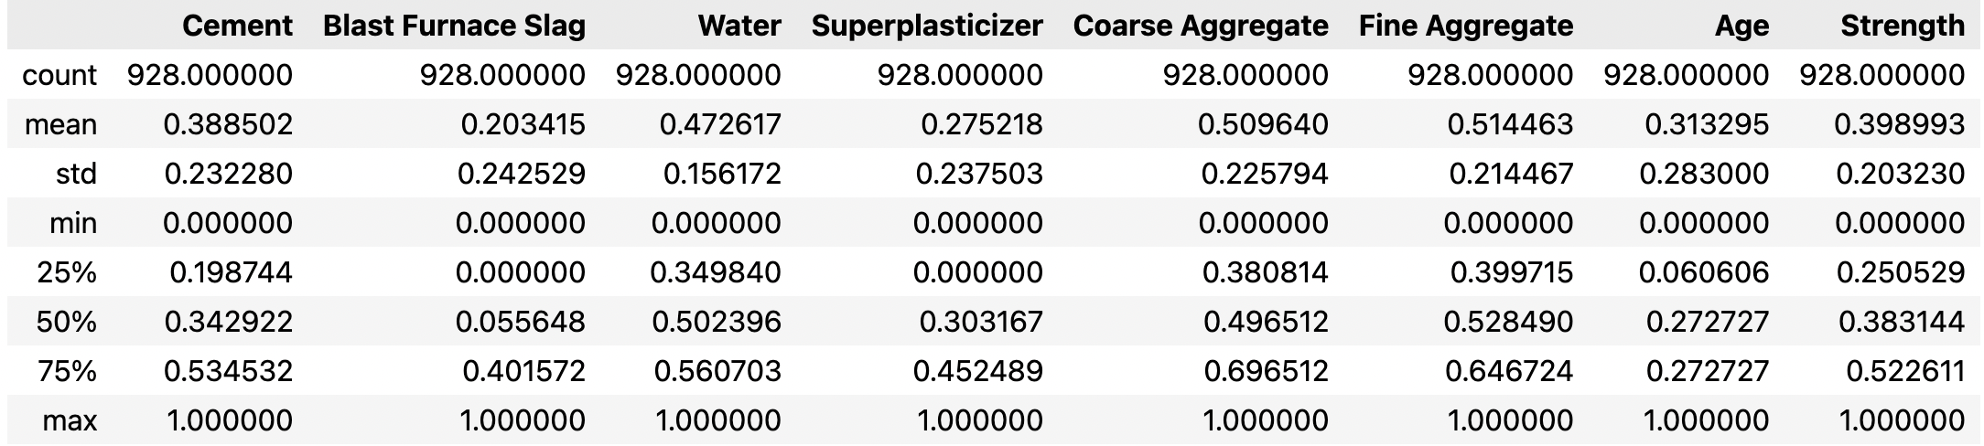

Data Standardization & Normalization
Data Standardization,
After standardization, $μ=0$
Data Normalization
$x_{norm}=\frac{x−x_{min}}{x_{max}−x_{min}}$
Notes:
Mohamed

Slide 10
Machine learning model Results : Test cases
Linear regression model, split the data by 80 (train) – (test) 20%
Feature removed | RMS | Accuracy | Scaling
Fly Ash | 0.473/ 0.0961 | 0.801 | Standardized /Normalized
Fly Ash, Water, Blast Furnace Slag, Coarse & Fine Aggregate | 0.622/ 0.126 | 0.657 | Standardized /Normalized
Fly Ash, Blast Furnace Slag, Coarse & Fine Aggregate | 0.606/0.123 | 0.674 | Standardized /Normalized
Notes:
Anish

Slide 11
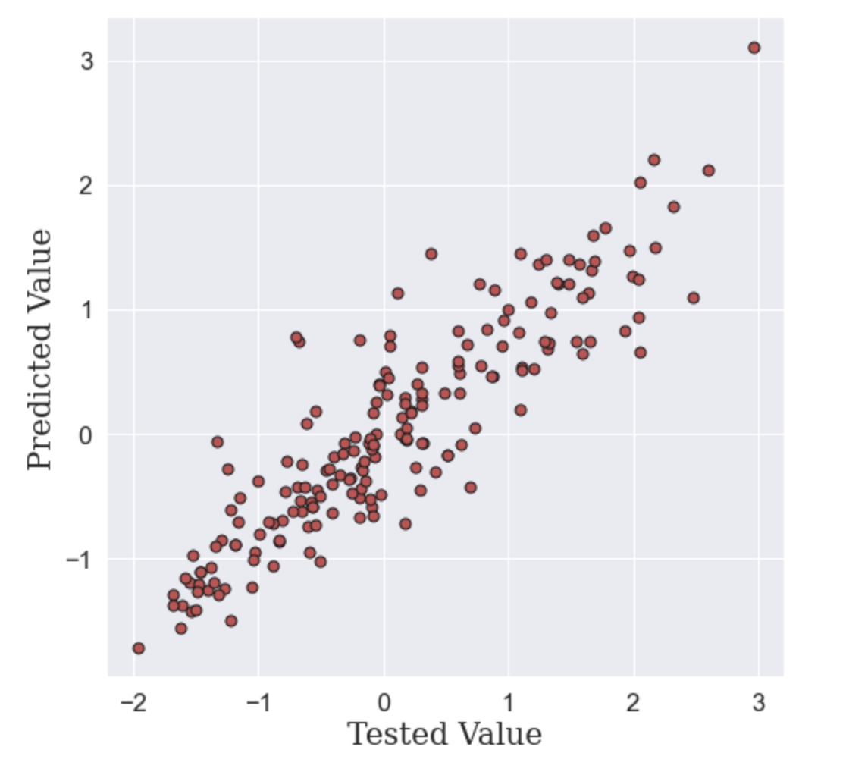
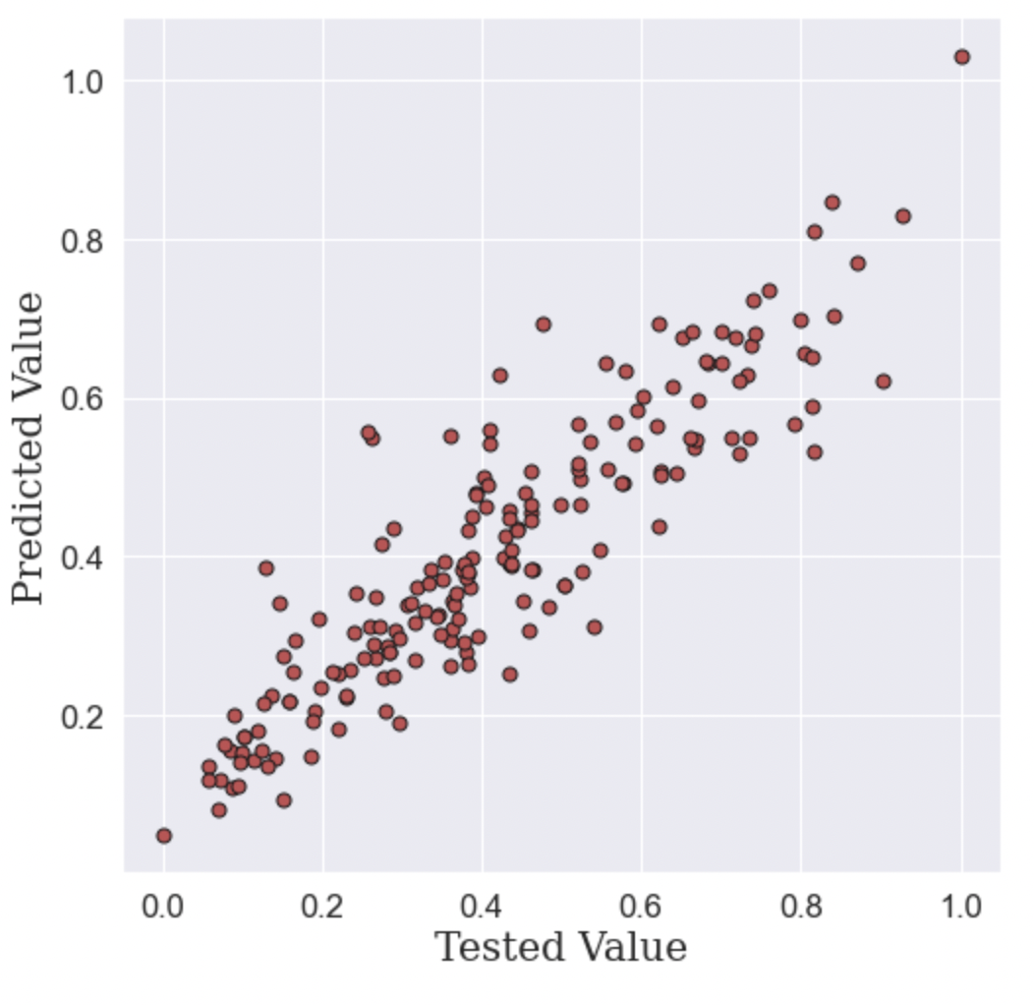
Standardized & Normalized
Notes:
Anish

Slide 12
Principal Component Analysis : PCA
Copy data frame and applied standardization.
Split them into features and target.
Calculate covariance Matrix.
Calculate the eigen values and Eigen vectors.
Reorder the Eigen vectors in descending order according to Eigen values and Compute the features weight.
Notes:
Mohamed.

Slide 13
PCA- CONT.
Feature | Eigen Value
Cement | 0.289
Water | 0.1785
Super Plasticizer | 0.159
Age | 0.127
Fine Aggregate | 0.120
Coarse Aggregate | 0.098
Fly ash | 0.0229
Blast Furnace slag | 0.003
Notes:
Mahmoud: highly weighted deature

Slide 14
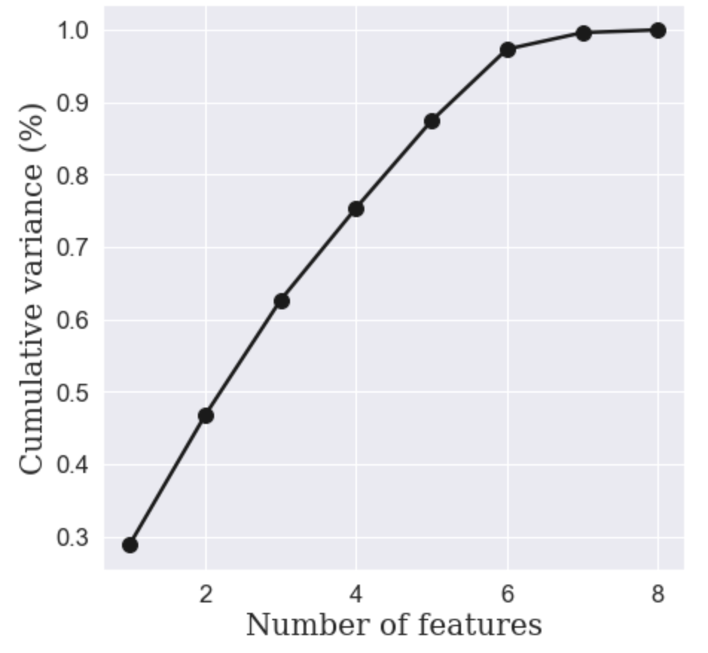
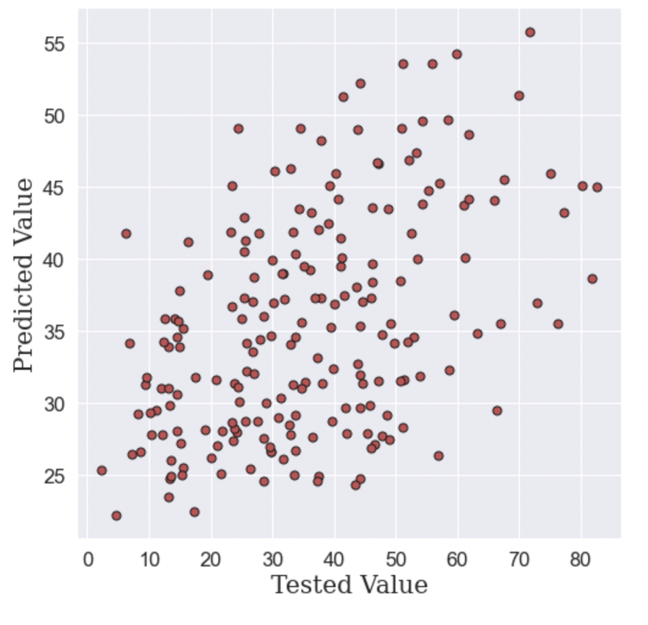
PCA-Results
K | RMS | Accuracy
2 | 15.247 | 0.2279
6 | 8.1176 | 0.788
K=2
Cumulative sum
Notes:
Anish

Slide 15
Conclusion
Linear regression model produced 0.801 accuracy upon excluding Fly Ash, excluding features gradually decreases model prediction accuracy.
Considering only two components in PCA reduced the model prediction accuracy to 22.79 %.
Considering 6 features (same as standard linear regression model) gave acceptable accuracy.
Notes:
Conclusion mahmoud

